Slide 1
Distributed Web-Based Systems

Slide 2
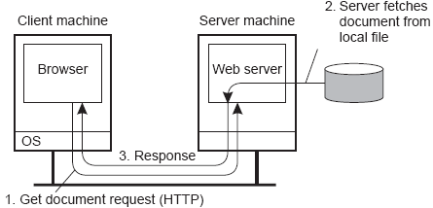
Distributed Web-based systems
Essence
The WWW is a huge client-server system with millions of servers; each server hosting thousands of hyperlinked documents.
Documents are often represented in text (plain text, HTML, XML)
Alternative types: images, audio, video, applications (PDF, PS)
Documents may contain scripts, executed by client-side software

Slide 3
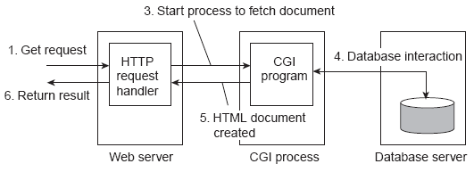
Multi-tiered architectures
Observation
Already very soon, Web sites were organized into three tiers.

Slide 4
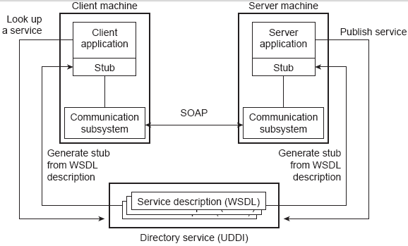
Web services
Observation
At a certain point, people started recognizing that it is was more than just user site interaction: sites could offer services to other sites standardization is then badly needed.

Slide 5
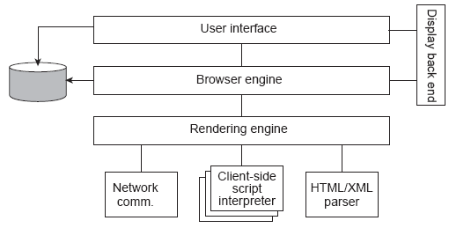
Clients: Web browsers
Observation
Browsers form the Web’s most important client-side sofware. They used to be simple, but that is long ago.

Slide 6
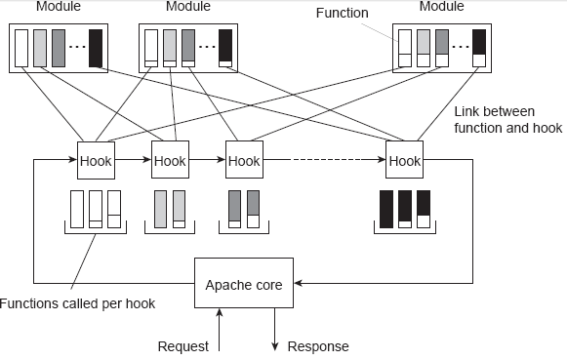
Apache Web server
Observation: More than 52% of all 185 million Web sites are Apache.
The server is internally organized more or less according to the steps needed to process an HTTP request.

Slide 7
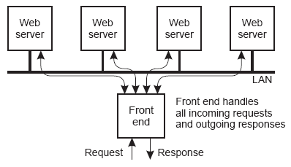
Server clusters
Essence
To improve performance and availability, WWW servers are often clustered in a way that is transparent to clients.

Slide 8
Server clusters
Problem
The front end may easily get overloaded, so that special measures need to be taken.
Transport-layer switching: Front end simply passes the TCP request to one of the servers, taking some performance metric into account.
Content-aware distribution: Front end reads the content of the HTTP request and then selects the best server.

Slide 9
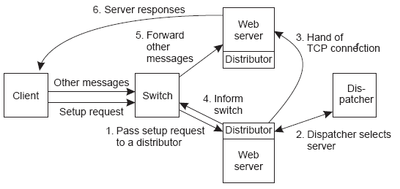
Server Clusters
Question
Why can content-aware distribution be so much better?

Slide 10
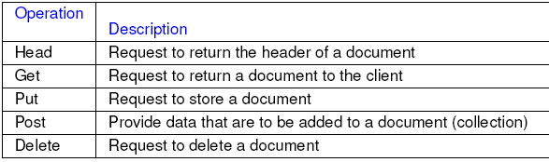
Communication
Essence
Communication in the Web is generally based on HTTP; a relatively simple client-server transfer protocol having the following request messages.

Slide 11
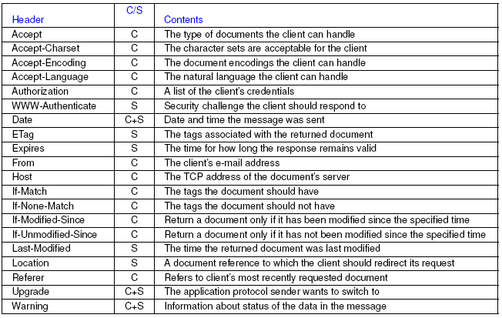
Communication

Slide 12
SOAP
Simple Object Access Protocol
Based on XML, this is the standard protocol for communication between Web services.
SOAP is bound to an underlying protocol (i.e., it is not independent from its carrier)
Conversational exchange style: Send a document one way, get a filled-in response back.
RPC-style exchange: Used to invoke a Web service.

Slide 13
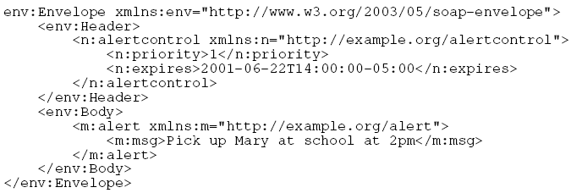
A Note on XML
Observation
XML has the advantage of allowing self-describing documents. Full stop (i.e., it introduces performance problems and is not meant to be read by human beings)

Slide 14
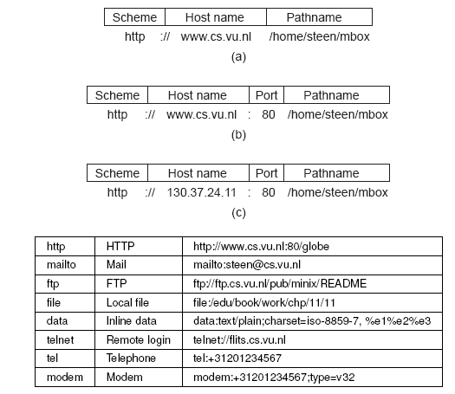
Naming: Uniform Resource Locator (URL)

Slide 15
Synchronization: WebDAV
Problem
There is a growing need for collaborative auditing of Web documents, but bare-bones HTTP can’t help here. Solution: Web Distributed Authoring and Versioning.
Supports exclusive and shared write locks, which operate on entire documents
A lock is passed by means of a lock token; the server registers the client(s) holding the lock
Clients modify the document locally and post it back to the server along with the lock token
Note
There is no specific support for crashed clients holding a lock.

Slide 16
Web proxy caching
Basic idea
Sites install a separate proxy server that handles all outgoing requests. Proxies subsequently cache incoming documents. Cache-consistency protocols:
Always verify validity by contacting server
Age-based consistency:

Slide 17
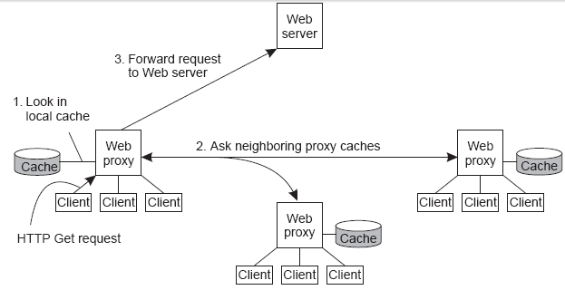
Web proxy caching
Basic idea (cnt’d)
Cooperative caching, by which you first check your neighbors on a cache miss

Slide 18
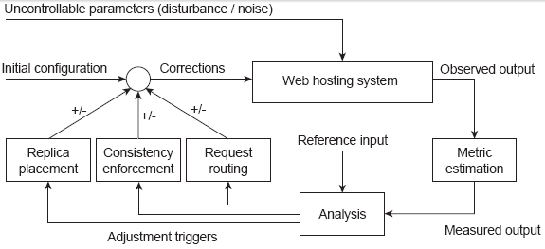
Replication in Web hosting systems
Observation
By-and-large, Web hosting systems are adopting replication to increase performance. Much research is done to improve their organization. Follows the lines of self-managing systems.

Slide 19
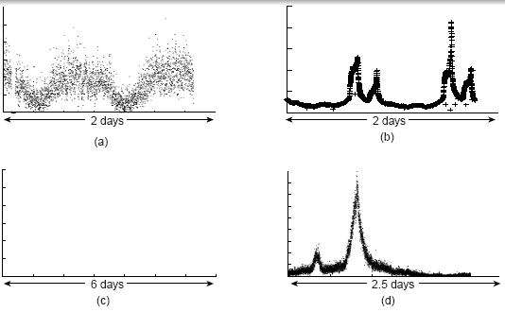
Handling flash crowds
Observation
We need dynamic adjustment to balance resource usage. Flash crowds introduce a serious problem.

Slide 20
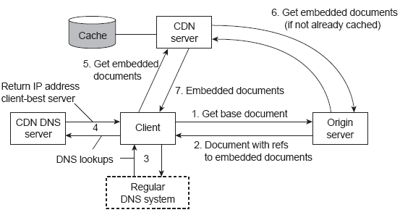
Server replication
Content Delivery Network
CDNs act as Web hosting services to replicate documents across the Internet providing their customers guarantees on high availability and performance (example: Akamai).

Slide 21
Replication of Web applications
Observation
Replication becomes more difficult when dealing with databses and such. No single best solution.
Assumption
Updates are carried out at origin server, and propagated to edge servers.

Slide 22
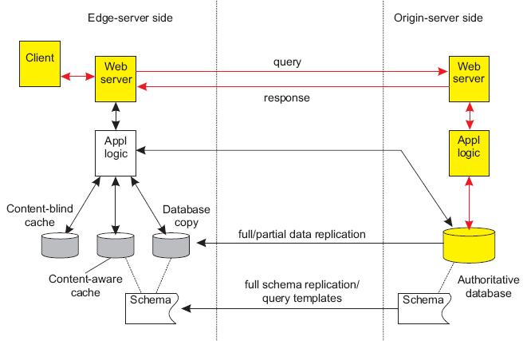
Replication of Web applications: normal

Slide 23
Replication of Web applications
Alternative solutions
Full replication: high read/write ratio, often in combination with complex queries.
Partial replication: high read/write ratio, but in combination with simple queries
Content-aware caching: Check for queries at local database, and subscribe for invalidations at the server. Works good with range queries and complex queries.
Content-blind caching: Simply cache the result of previous queries. Works great with simple queries that address unique results (e.g., no range queries).
Question
What can be said about replication vs. performance?

Slide 24
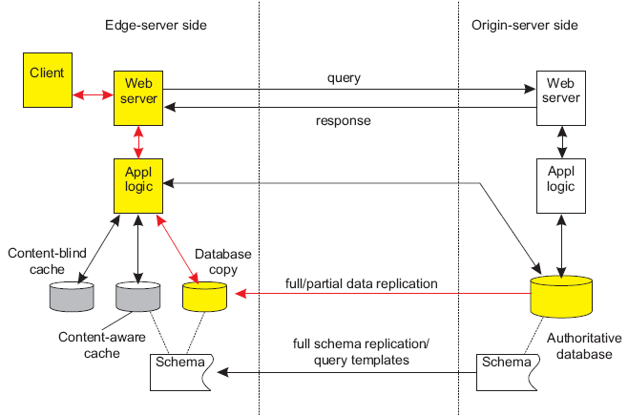
Replication Web apps.: full/partial replication

Slide 25
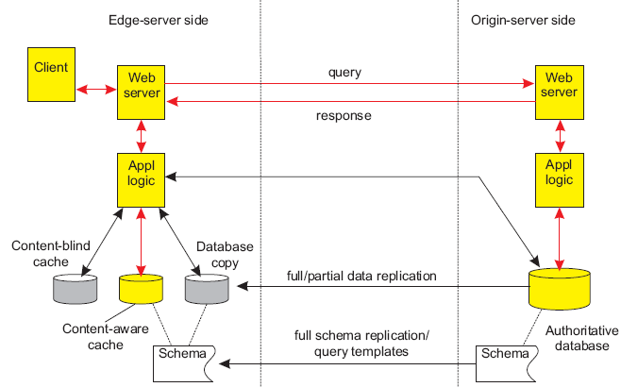
Replication Web apps.: content-aware caching

Slide 26
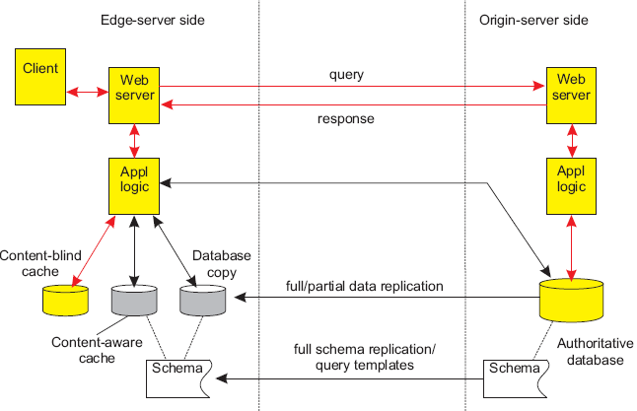
Replication Web apps.: content-blind caching

Slide 27
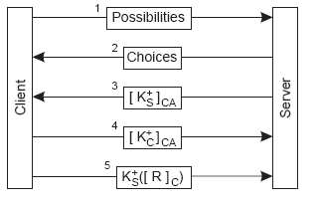
Security: TLS (SSL)
Transport Layer Security
Modern version of the the Secure Socket Layer (SSL), which “sits” between transport layer and application protocols. Relatively simple protocol that can support mutual authentication using certificates.

